Slide 1

DESIGN AND ANALYSIS OF ALGORITHMS
Dr. Kashif Ayyub

Slide 2
Asymptotic Analysis
Asymptotic Notations are mathematical tools used to analyze the performance of algorithms by understanding how their efficiency changes as the input size grows.
These notations provide a concise way to express the behavior of an algorithm’s time complexity as the input size.
Rather than comparing algorithms directly, asymptotic analysis focuses on understanding the relative growth rates of algorithms’ complexities.
It enables comparisons of algorithms’ efficiency by abstracting away machine-specific constants and implementation details, focusing instead on fundamental trends.
Asymptotic analysis allows for the comparison of algorithms’ time complexities by examining their performance characteristics as the input size varies.

Slide 3
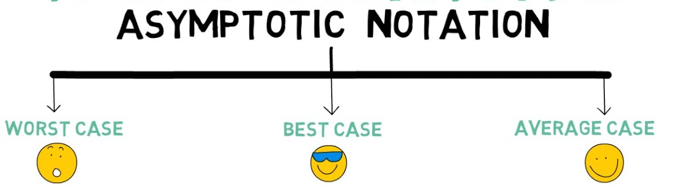
Asymptotic Analysis
The time required by the algorithm falls under the three types:
Worst case - Maximum time required by an algorithm and it is mostly used or done while analyzing the algorithm.
Best case - Minimum time required for the algorithm or piece of code and it is not normally calculated while analyzing the algorithm.
Average case - Average time required for an algorithm or portion of code and it is sometimes done while analyzing the algorithm.

Slide 4
Best Case Analysis (Optimistic Scenario)
The best case scenario represents the most favorable conditions for an algorithm's execution.
It assumes the input is perfectly aligned to allow the algorithm to perform with the least possible number of steps.
Example:
Linear Search: The best case in a linear search algorithm occurs when the target element is the first element in the list.
Binary Search: For binary search, the best case happens when the middle element (first checked) is the target element.
Sorting Algorithms (like Bubble Sort): In bubble sort, the best case occurs when the array is already sorted.
Importance:
Helps in identifying the 'lower bound' of algorithm performance.
However, it's often less relied upon as it can be overly optimistic and not indicative of typical performance.

Slide 5
Worst Case Analysis (Pessimistic Scenario)
The worst case scenario considers the most challenging or demanding situation for an algorithm.
It's crucial for understanding the maximum time or resources an algorithm might require.
Example:
Linear Search: In a linear search algorithm, the worst case occurs when the element being searched for is not present in the array or is at the very end. The algorithm has to check each element, leading to a time complexity of O(n).
Sorting Algorithms (like Quick Sort): For Quick Sort, the worst case happens when the pivot element selected at each step is the smallest or largest element, leading to imbalanced partitions. This results in a time complexity of O(n²).
Graph Algorithms (like Dijkstra’s Algorithm): In Dijkstra’s algorithm for finding the shortest path, the worst case is when the algorithm has to traverse all vertices and edges in the graph, leading to a time complexity of O(V²) for basic implementations, where V is the number of vertices.
Importance:
Helps in identifying the ‘upper bound' of algorithm performance.
In the least favorable scenario, how badly could this algorithm perform?

Slide 6
Average Case Analysis (Realistic Scenario)
This analysis seeks to ascertain the algorithm's performance under typical or average conditions.
It often requires probabilistic or statistical methods to determine, as it depends on the distribution of input data.
Example:
Linear Search: It would involve calculating the expected number of comparisons for a randomly chosen target in the array.
Quick Sort Algorithm: In the average case, Quick Sort partitions the array into roughly equal parts. The average time complexity is O(n log n), which is generally achieved with good pivot selection.
Binary Search: In a balanced binary search tree, the average case for search, insert, and delete operations is O(log n), assuming that the tree remains balanced.
Importance:
Falling between the best and worst extremes, the average case analysis attempts to ascertain the algorithm's performance under 'typical' or 'average' conditions.
It provides a more realistic measure of an algorithm's efficiency in typical usage scenarios, compared to the best and worst case analyses.

Slide 7
Asymptotic Notations
Time function of an algorithm is represented by T(n), where n is the input size.
Different types of asymptotic notations are used to represent the complexity of an algorithm.
Following asymptotic notations are used to calculate the running time complexity of an algorithm.
O − Big Oh
Ω − Big Omega
θ − Big Theta
o − Little Oh
ω − Little Omega

